Slide 1
Data scientist: qualifications and skills
Jeff Leek
@jtleek
www.jtleek.com

Slide 2
What does a data scientist do?
Design experiments
Pull and clean data
Analyze data
Communicate results

Slide 3
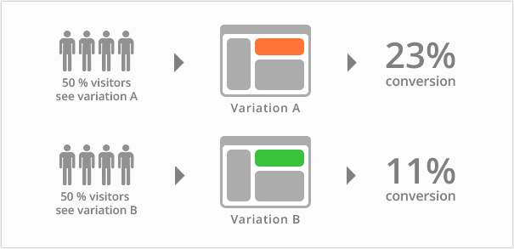
https://vwo.com/ab-testing/

Slide 4
What skills do they need?
Statistics (inference)
Machine learning (prediction)
Data analysis
Data communication

Slide 5
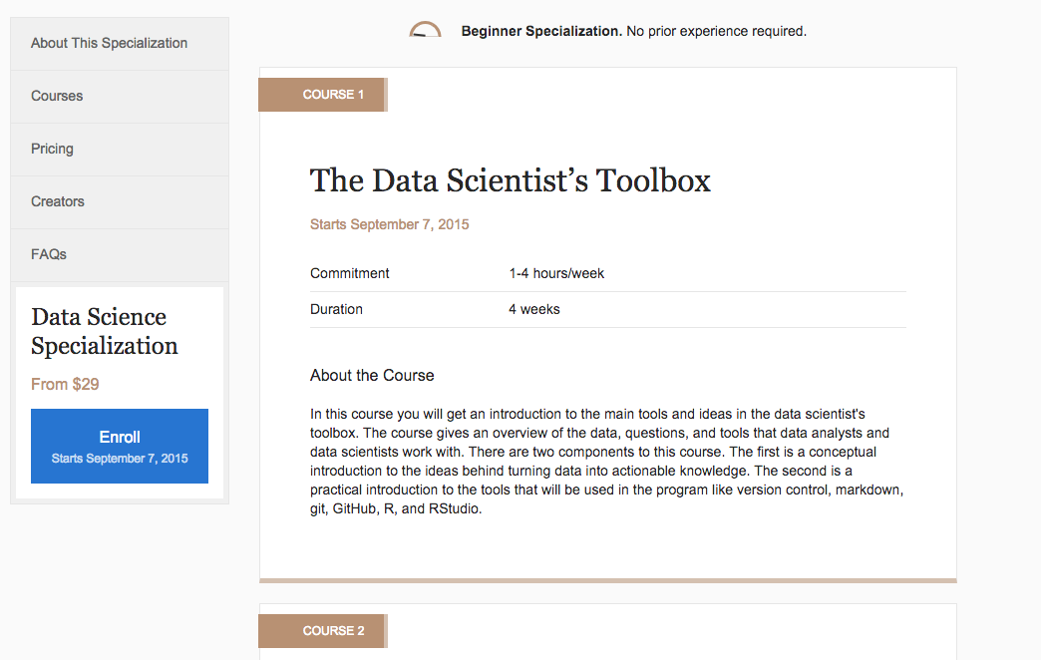
https://www.coursera.org/specializations/jhudatascience

Slide 6
Background of data scientists
Statistics + application + engineering
Quantitative + data science transition
Software engineering + statistics

Slide 7
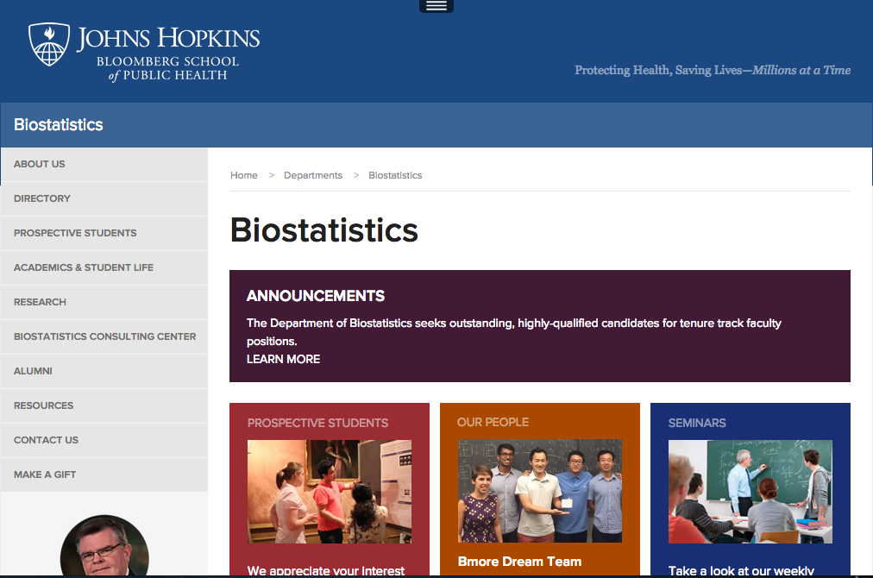
http://www.jhsph.edu/departments/biostatistics/

Slide 8
Solutions versus software

Slide 9
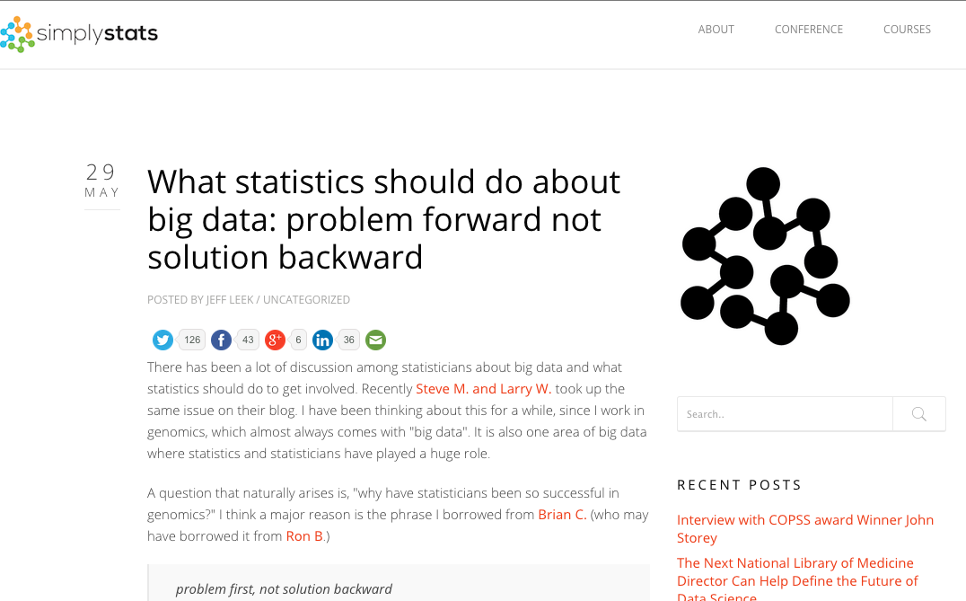
http://simplystatistics.org/2013/05/29/what-statistics-should-do-about-big-data-problem-forward-not-solution-backward/

Slide 10
Key characteristics
Willing to find answers on their own
Unintimidated by new data
Willing to say I don’t know
Friendly but relentless

Slide 11
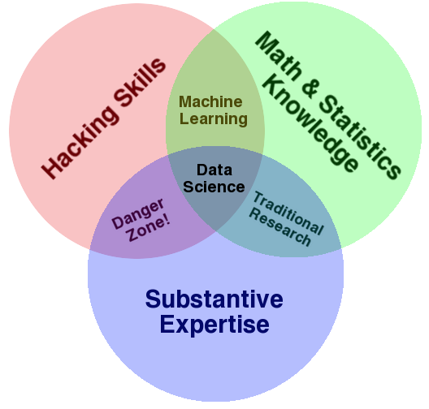
http://drewconway.com/zia/2013/3/26/the-data-science-venn-diagram
friendly! +

